Slide 1
Developing a CDAO Mindset: A Quick Guide for Technical Professionals
Downloadable Figures
Jason Medd, Saul Judah
Notes:
Presenter's Name
Presenter's Name

Slide 2
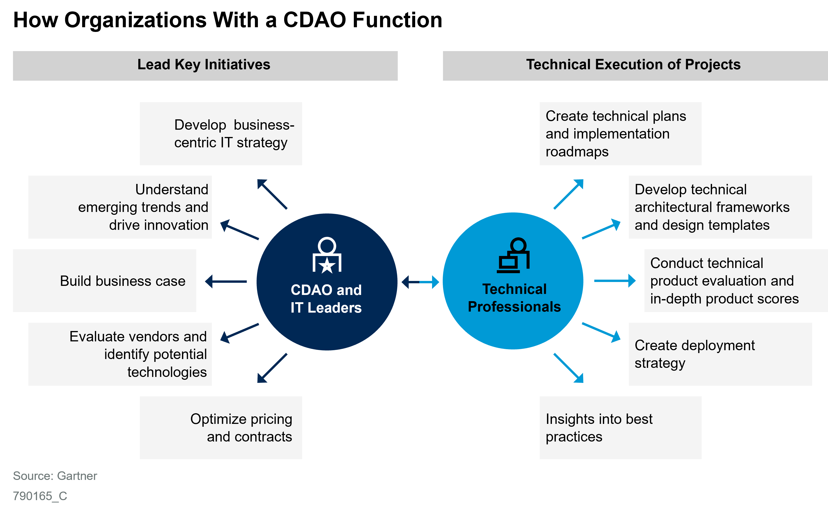
Figure 1

Slide 3
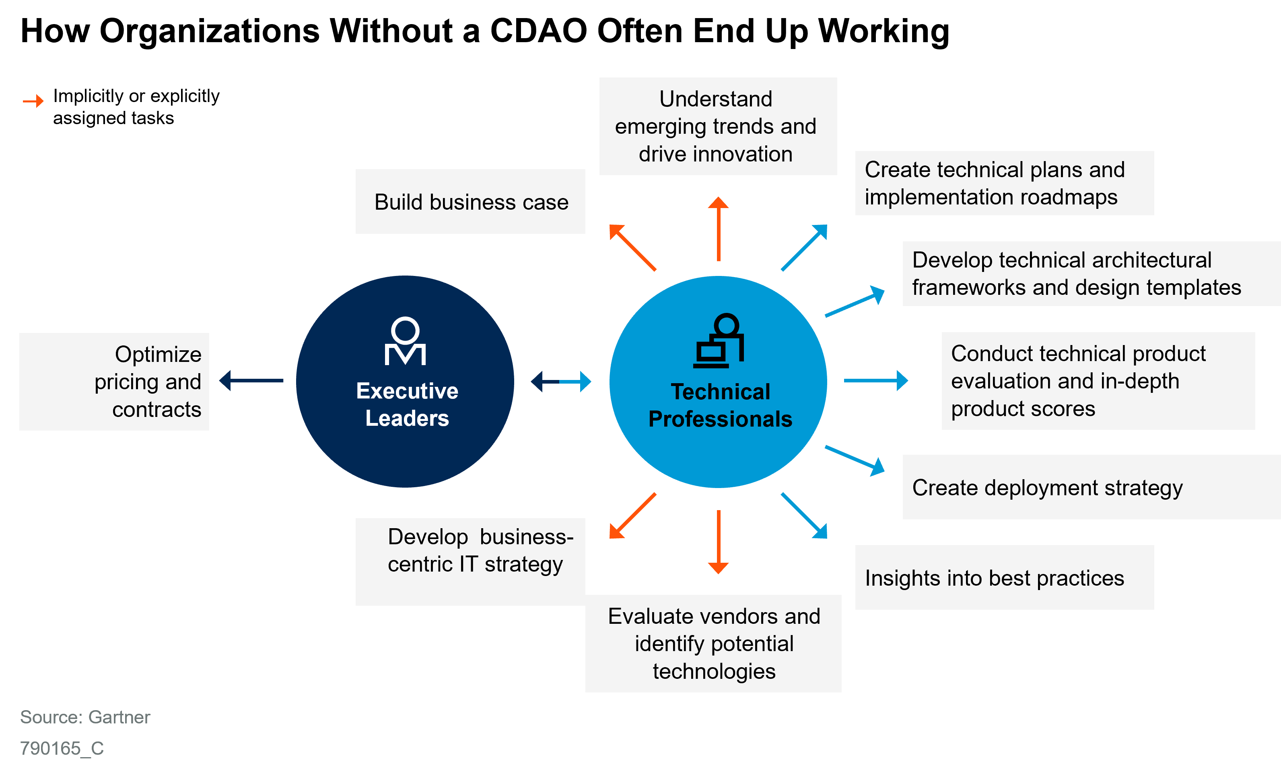
Figure 2

Slide 4
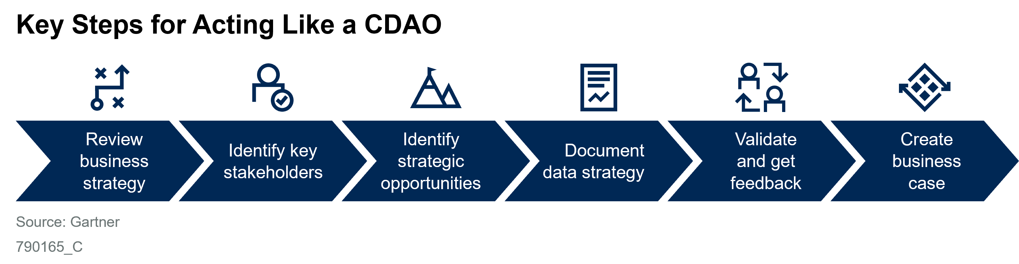
Figure 3

